Slide 1
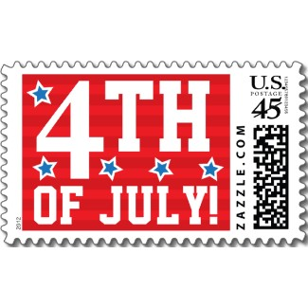
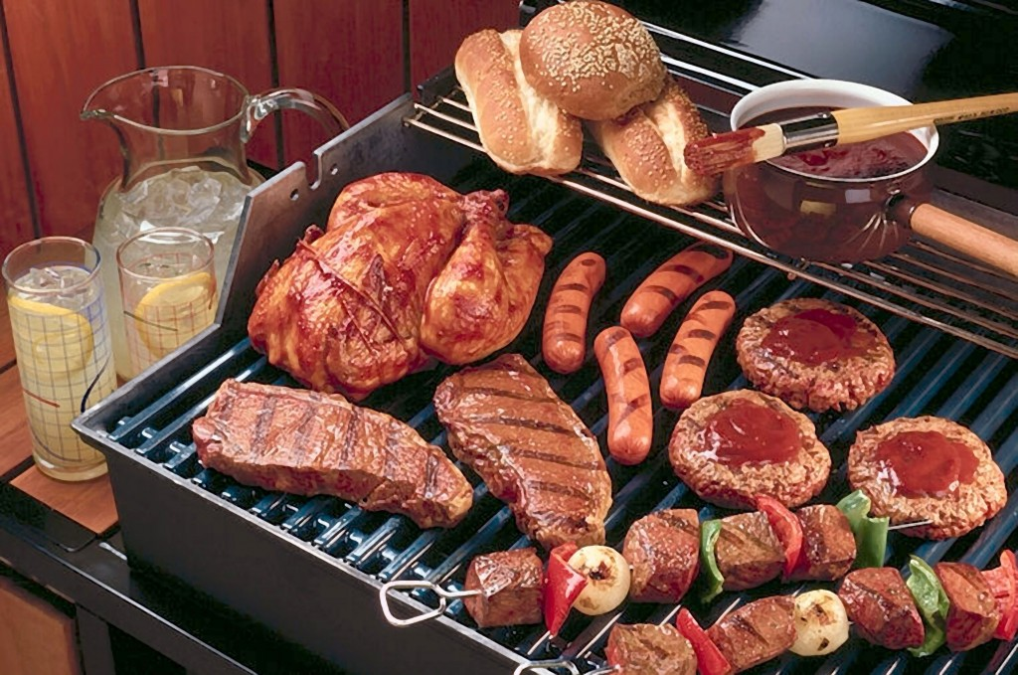
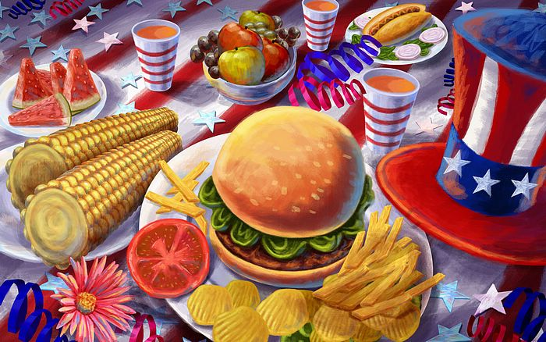
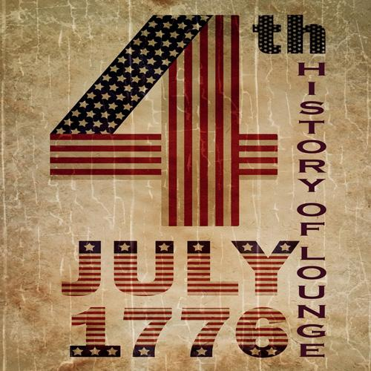
Independence day

Slide 2
Independence Day is national holiday in the USA. Americans call Indipendence Day the 4th of July, as on this they in 1776 the government declared its independence from Britain. Americans celebrate this day with barbecues or picnic with families and they organize a block party. In many cities there are parades in the morning or early afternoon. In every parade there is someone dressed as uncle Sam, a famous American icon representing the American government. After the parades there are fireworks in public parks but if the weather is bad people go to the cinema because the 4 july is a big day for new films.

Slide 3
