Slide 1
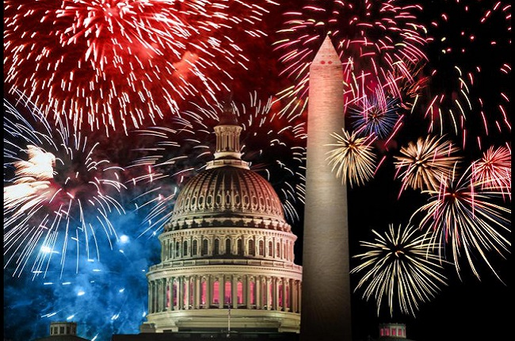
Independence Day
Fourth Of July

Slide 2
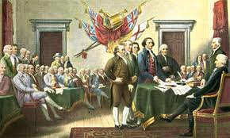
Independence Day is a national holiday in USA.
On the 4° july 1776 the United States governement declared its indipendence from Britain
The fourth july is still very important for Americans

Slide 3
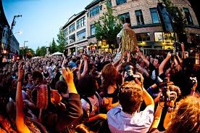
Americans celebrate independence day outdoors because it’s summer and the wheather is good.
They have barbeques or picnics with their families. Sometimes they get together with other families and they organize a block party. They’re like British street party. People eat hot dogs and hamburgers and there’s music and dancing

Slide 4
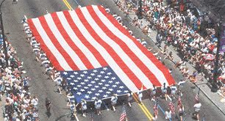
In many cities there are independence day parades.People wawe the american flag and wear national colurs.In big parades there are also big baloons shaped like animals
In every parades there’s always someone dressed like Uncle Sam ,a famous american icon ,representing the american governement.Uncle Sam is an old man with a withe beard ,and he wear clothes made out with te American flag

Slide 5
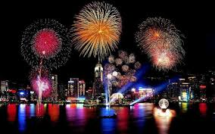
In New York you can see fireworks across the Hudson river .
In the evening there are fireworks in public parks and in people’s garden.
In Chigago you can watch them over the lake Michigan.
In San Francisco over the famuos Golden Bridge and Alcatraz island.

