Slide 1
MARTIN LUTHER KING
A brief biography

Slide 2
Martin Luther King Jr. was born in 1929 in Atlanta, Georgia.

Slide 3
He attended segregated public schools and then went to Boston University where he graduated in 1955.

Slide 4
In 1954 Martin Luther King became a pastor in the Baptist Church in Montgomery, Alabama.

Slide 5
While he was still a student he became enthusiastic about the writings of Mahatma Gandhi, who advocated non-violent protest.

Slide 6
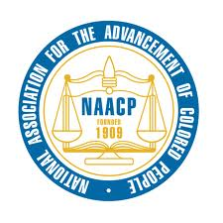
He was a member of the NAACP (National Association for the Advancement of Colored People).

Slide 7
In 1955 he led the first black non-violent demonstration in the United States: the bus boycott of the Montgomery Bus Company.

Slide 8
On December 1st, 1955 a black woman called Rosa Parks was arrested because she had taken a seat reserved for white people on a bus.

Slide 9
Black people stopped using segregated buses in Montgomery for 382 days.

Slide 10
In April 1963 Martin Luther King led a very big peaceful protest against segregation in Birmingham, Alabama.

Slide 11
After the protest King was arrested and while he was in prison he wrote the “Letter from a Birmingham Jail” which became a manifesto of the Negro Revolution.

Slide 12
On August 28th, 1963 King organized a great peaceful march for civil rights to Washington D.C.: there were about 250,000 people.

Slide 13
In his famous speech, “I have a dream”, King talked about his hopes for the future when black and whites could be brothers.

Slide 14
In 1964, at the age of 35, Martin Luther King became the youngest man to receive the Nobel Peace Prize.

Slide 15
In 1965 the American Congress passed the “Voting Rights Act” which gave black people the right to vote.

Slide 16
On April 4th 1968, while he was standing on the balcony of his motel room in Memphis, Tennessee Martin Luther King was assassinated.

