Slide 1
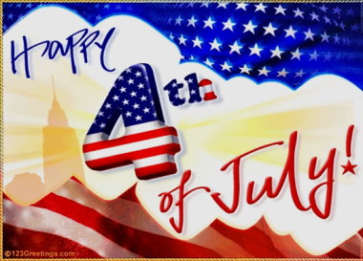
Notes:
1

Slide 2
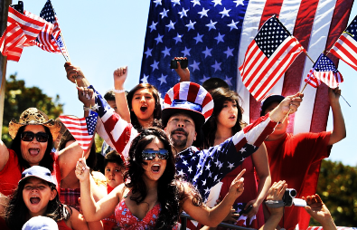
Independence Day is a national holiday in the USA. It's very important because in 1776 the United States Governament declared its independence from Britain. Today this day is very important for Americans.
Notes:
2

Slide 3
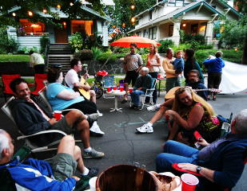
On Independence Day American people celebrate outdoors. They have barbecues or picnics in their gardens and they eat hamburgers and hot dogs. People can stay with their families or they can organise a “Block Party” in the streets with other families. After lunch there's music and dancing.
Notes:
3

Slide 4
In many cities of the USA there are Independence Day parades. At the parades people wave the American flag and wear the national colours: red, white, blue. Independence Day parades are in the morning or early afternoon and they often represent American history. In these parades there is always someone dressed as Uncle Sam. Uncle Sam is a famous American icon representing the American Governament.
Notes:
4

Slide 5
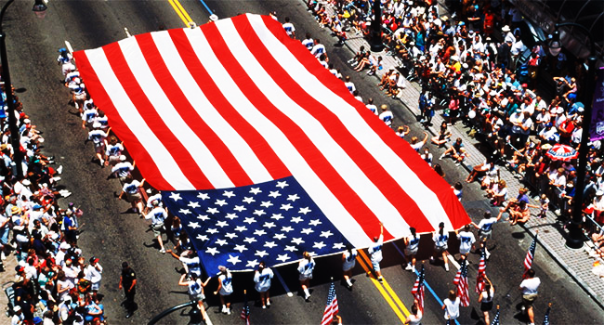
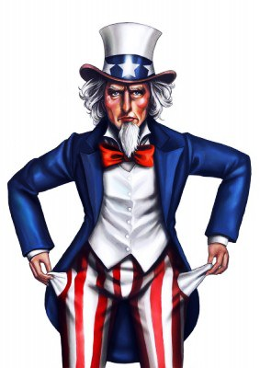
Notes:
5

Slide 6
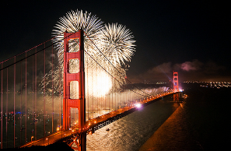
In the evening, after parades, there are fireworks in public parks and in people's garden. In New York you can watch these fireworks across the Hudson River. In Chicago you can see them over Lake Michigan and in San Francisco over the famous Golden Gate Bridge and Alcatraz Island.
Notes:
6

Slide 7
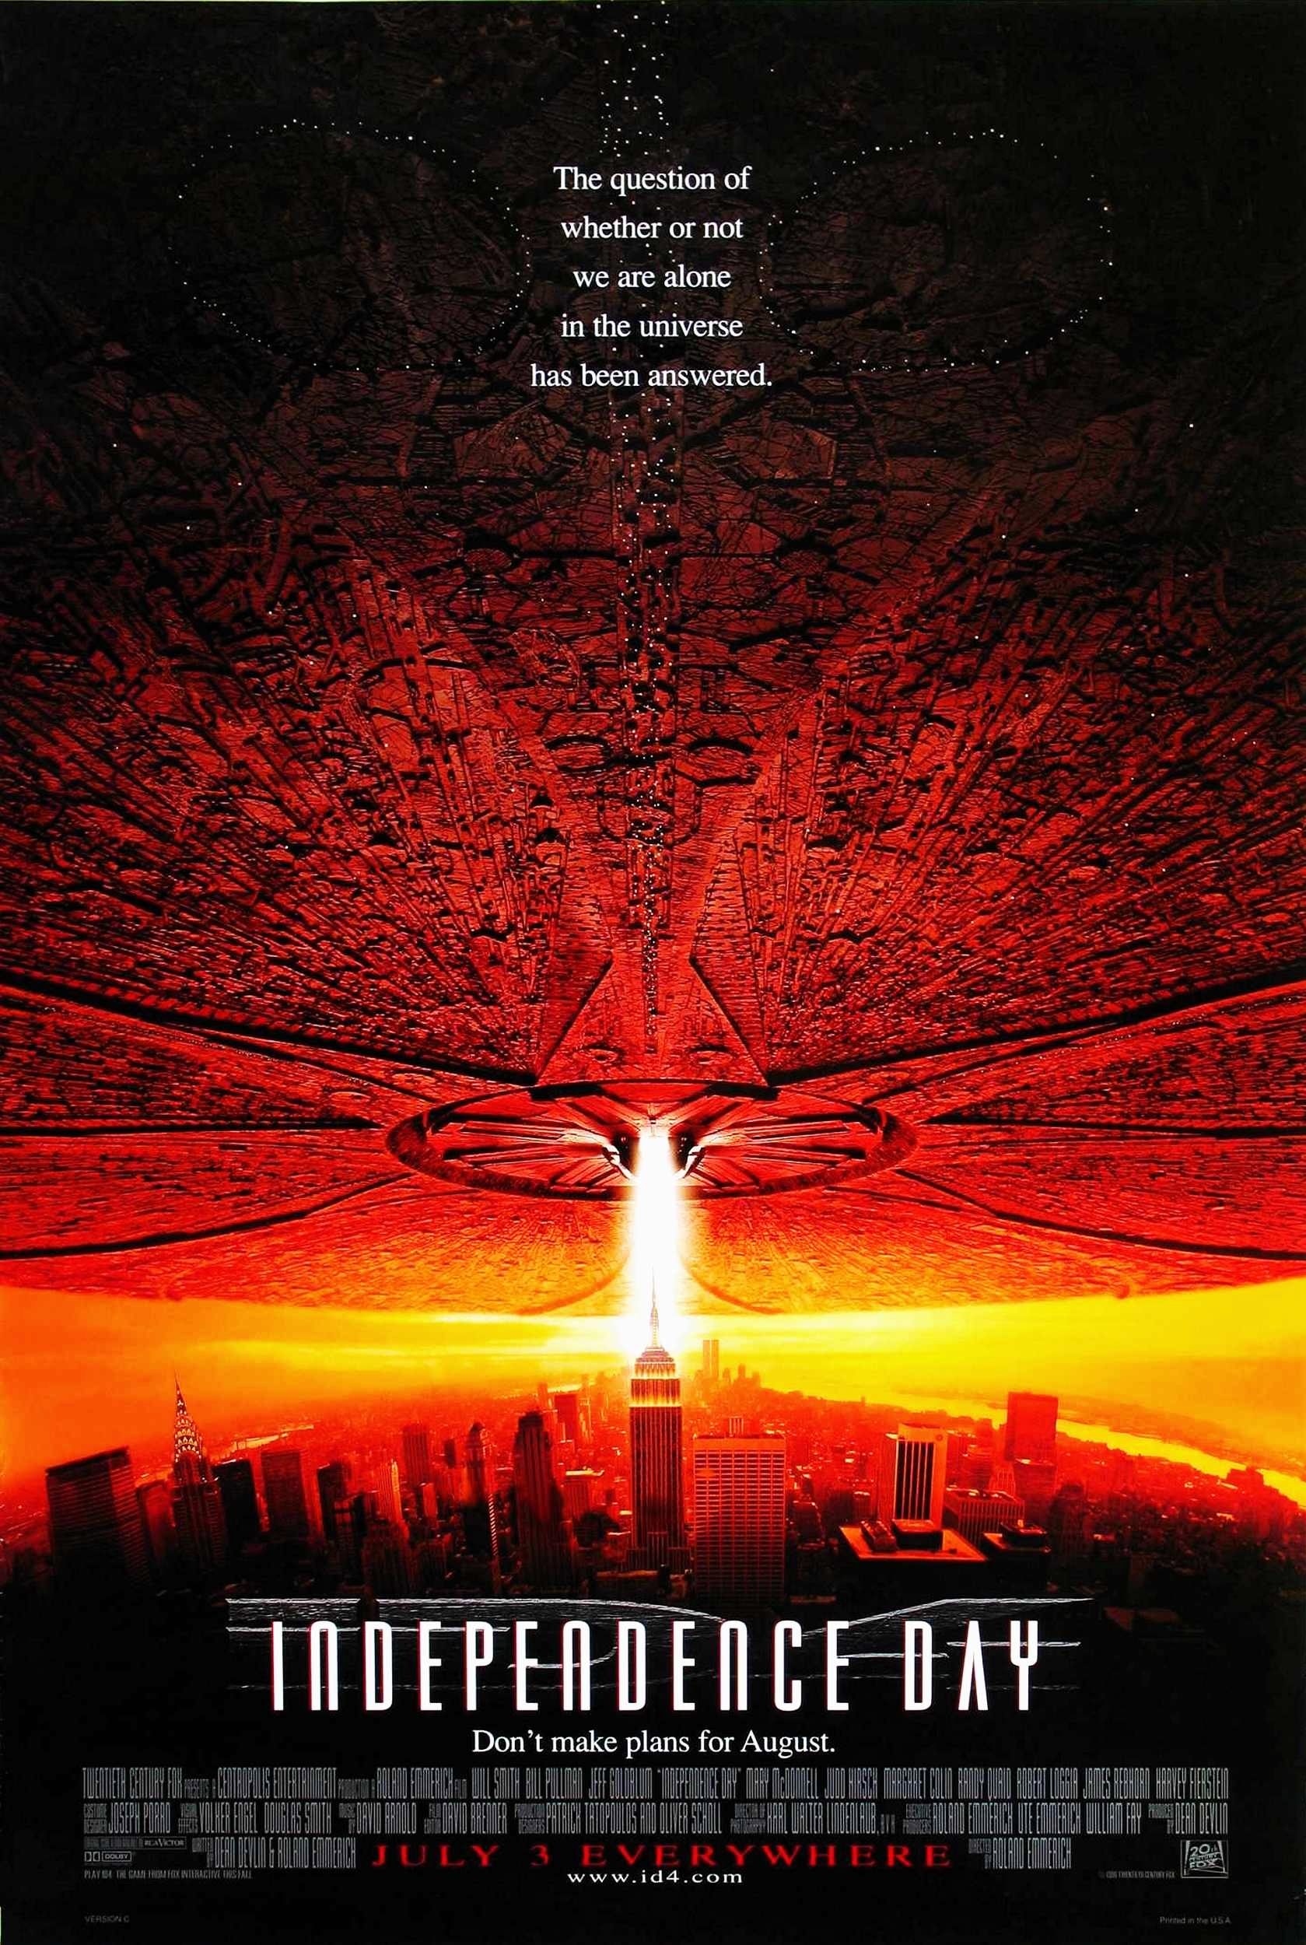
If the weather is bad on Independence Day, you can always go to the cinema. At the cinema you can watch new films, for example, blockbusters such as Spider-Man and Transformers, came out Independence Day
Notes:
7

