Slide 1
Past simple
revision

Slide 2
Affirmative form
Regular verbs:
Soggetto + verbo + ed
(un’unica forma per tutte le persone)

Slide 3
Affirmative form
Regular verbs - examples
play – played
work – worked
listen – listened
call - called
Ricorda:
study – studied
travel – travelled
stop - stopped

Slide 4
Affirmative form
Irregular verbs (un’unica forma per tutte le persone)
Soggetto + passato irregolare
(seconda colonna della tabella dei verbi irregolari)

Slide 5
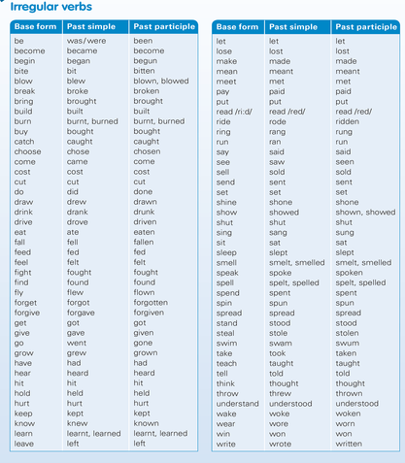

Slide 6
Negative form
per tutti i verbi (regolari e irregolari – un’unica forma per tutte le persone)
Soggetto + did + not + verbo
didn’t (forma base)

Slide 7
Negative form
Examples
play – didn’t play
work – didn’t work
go – didn’t go
run – didn’t run
stay – didn’t stay
sing – didn’t sing
stop – didn’t stop
buy – didn’t buy
live – didn’t live
come – didn’t come

Slide 8
Interrogative form
per tutti i verbi (regolari e irregolari – un’unica forma per tutte le persone)
Did + soggetto + verbo ?
(forma base)
Ausiliare (A) + soggetto (S) + verbo (V)? A+S+V?

Slide 9
Short answers
Yes + Soggetto + did
(pronome)
No + Soggetto + didn’t
(pronome)

Slide 10
Interrogative form
Examples
Did you play football yesterday? Yes, I did.
Did the students do a test on Monday? No, they didn’t
Did your mum go to work last week? Yes, she did.
Did you finish your projects? No, we didn’t.
Did the teacher give you homework? Yes, he did.
Ricorda: A + S + V + (…)?

Slide 11
Interrogative form – WH questions
WH + did + soggetto + verbo ?
(forma base)
Parola interrogativa (WH) + Ausiliare (A) + soggetto (S) + verbo (V)?
WH + A + S + V?

Slide 12
Interrogative form – WH questions
Examples
Where did you go last night? I went to the cinema.
When did the children play football? On Monday.
What did your mum buy at the supermarket? She bought some apples.
Who did they meet at the airport? They met their parents.
Ricorda: WH + A + S + V + (…)?

